Slide 1

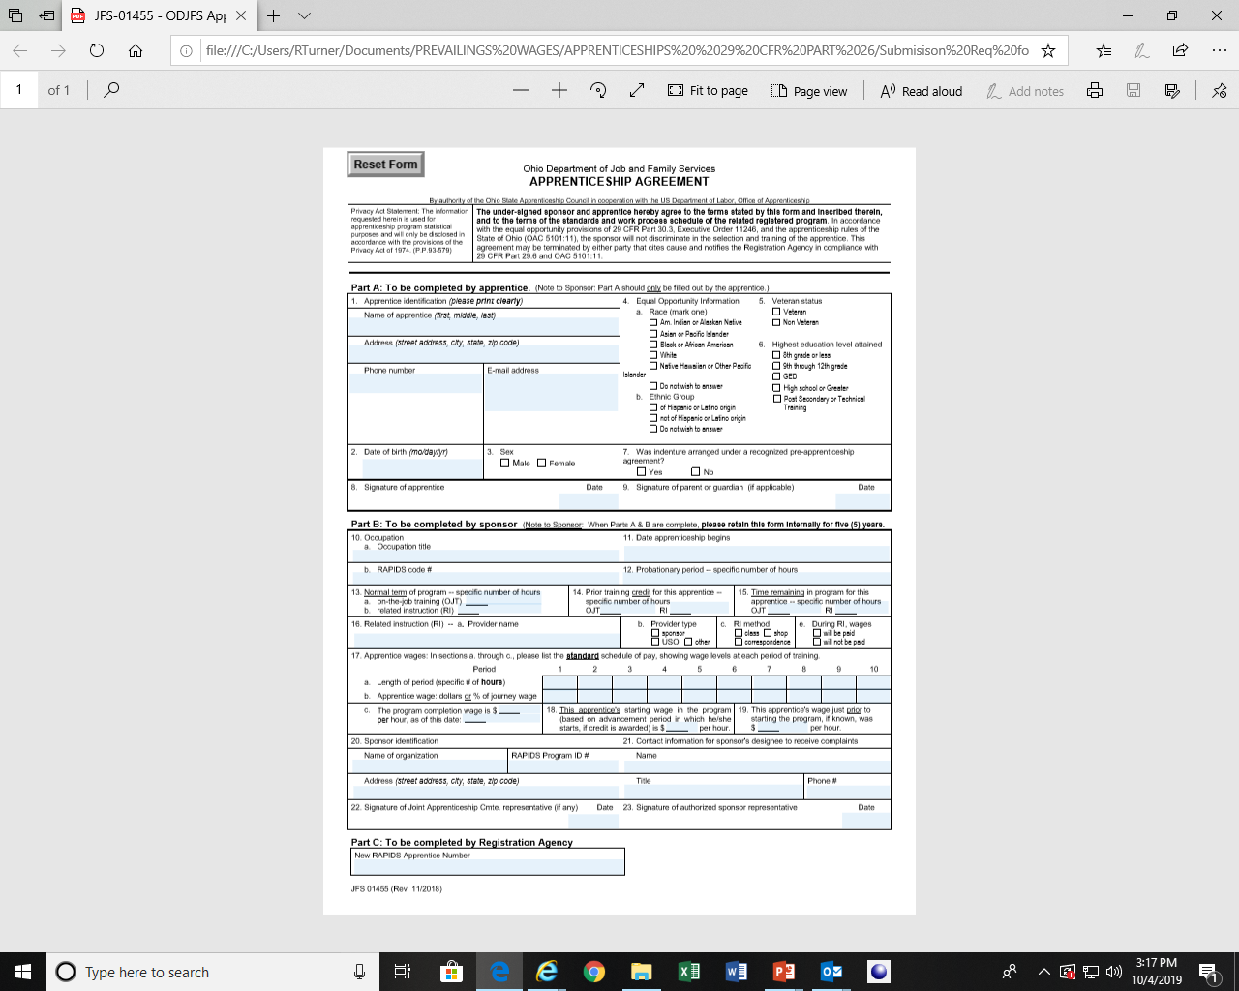
APPRENTICES/TRAINEES REQUIREMENTS
1. Apprenticeship Agreement
Notes:
1

Slide 2
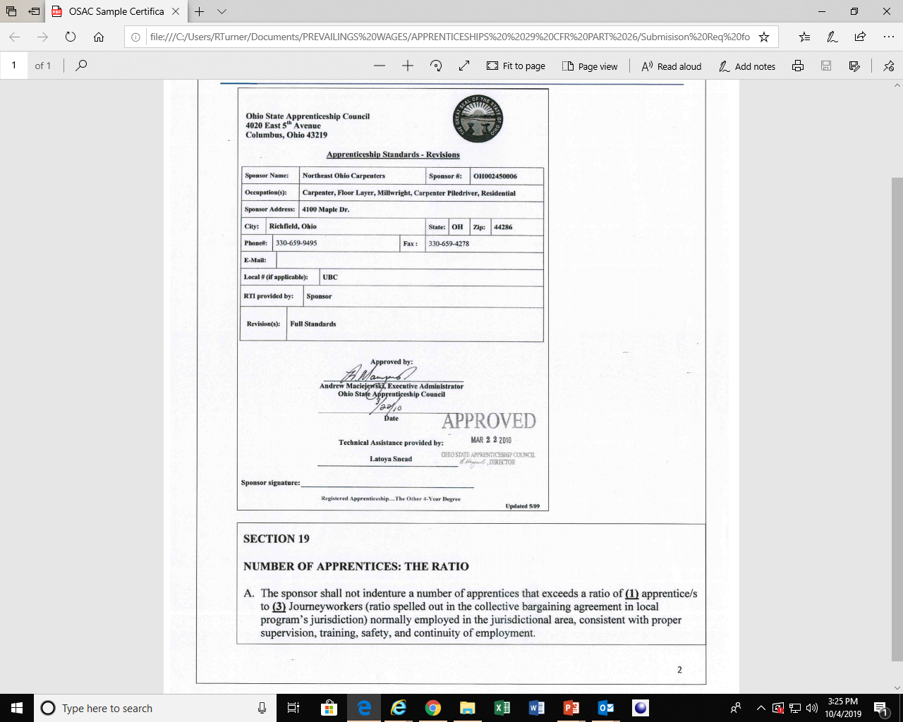
APPRENTICES/TRAINEES REQUIREMENTS
2. APPROVED by the Ohio State Apprentice Council
Notes:
2

