Slide 1
Noise Compatibility Report 2019 2nd Quarter
`
September 4th, 2019

Slide 2
Disclaimer
Adherence to approved noise abatement measures is voluntary and subject to change based on weather, efficiency, and safety.
The contents of this report are for informational purposes only. The information cannot be used for enforcement of any Noise Abatement Measure.
Totals may not add to 100.0%, due to rounding.

Slide 3
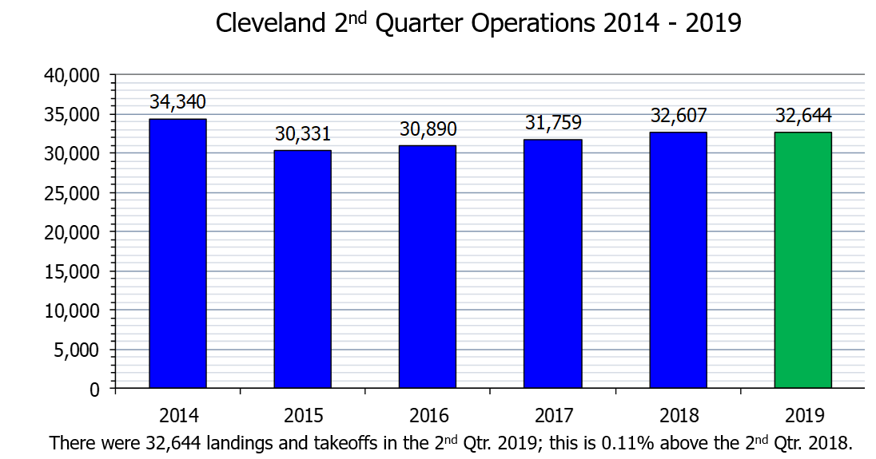
Aircraft Operations

Slide 4
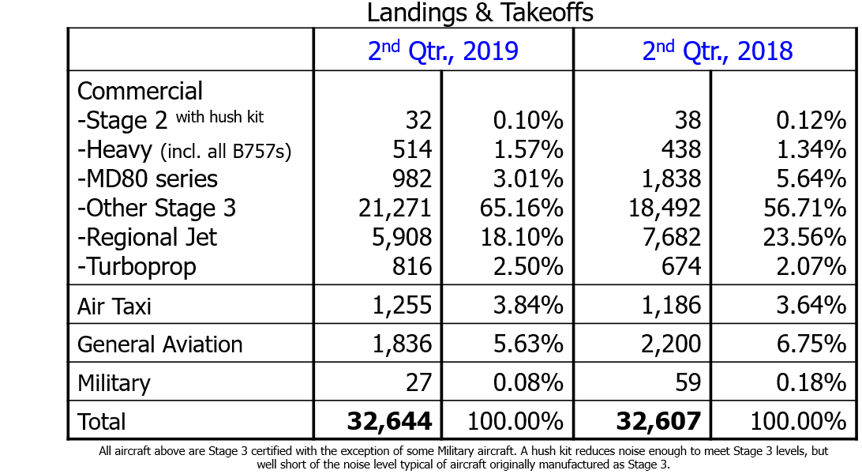
Fleet Mix

Slide 5
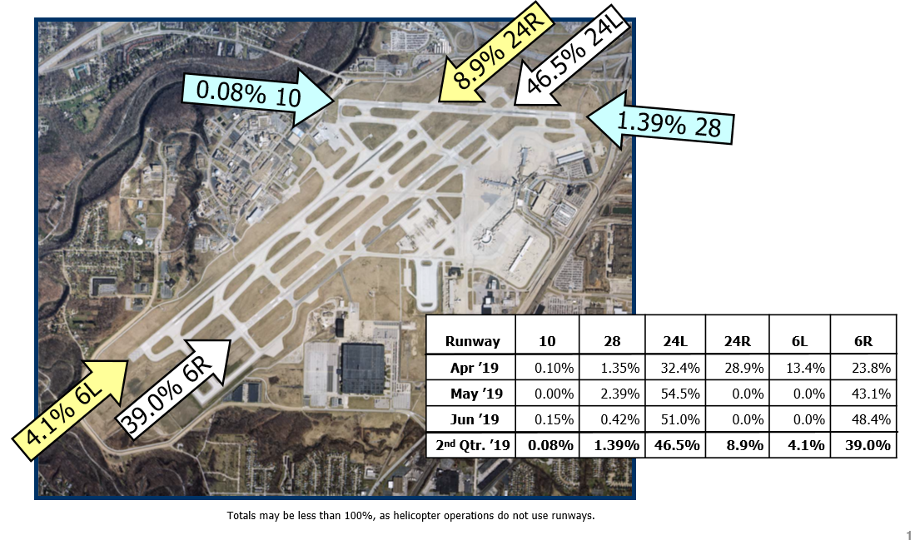
Runway Use: 2nd Qtr., 2019 Arrivals

Slide 6
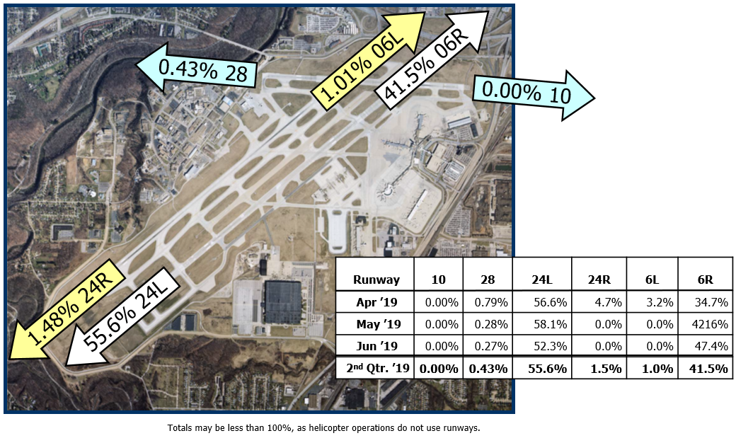
Runway Use: 2nd Qtr., 2019 Departures

Slide 7
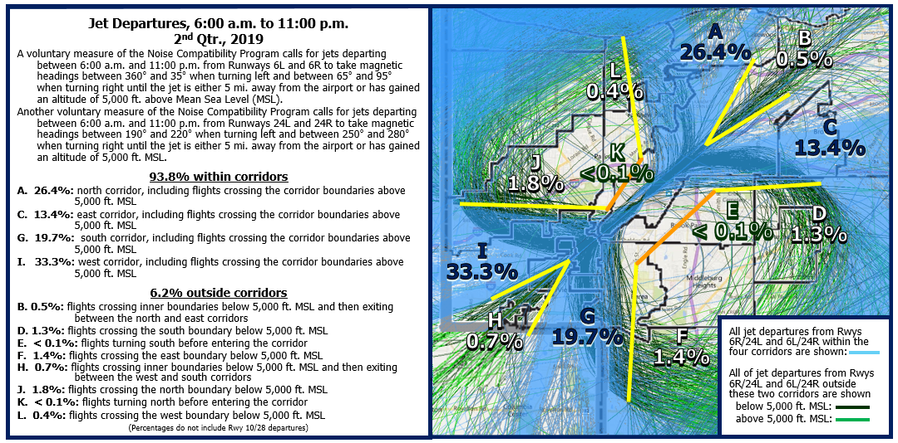
Departure Headings, 2nd Qtr.: Day-time

Slide 8
“Existing” Radar tracks were selected from 2013.
Metroplex took effect Sep., 2018.

Slide 9
“Existing” Radar tracks were selected from 2013.
Metroplex took effect Sep., 2018.

Slide 10
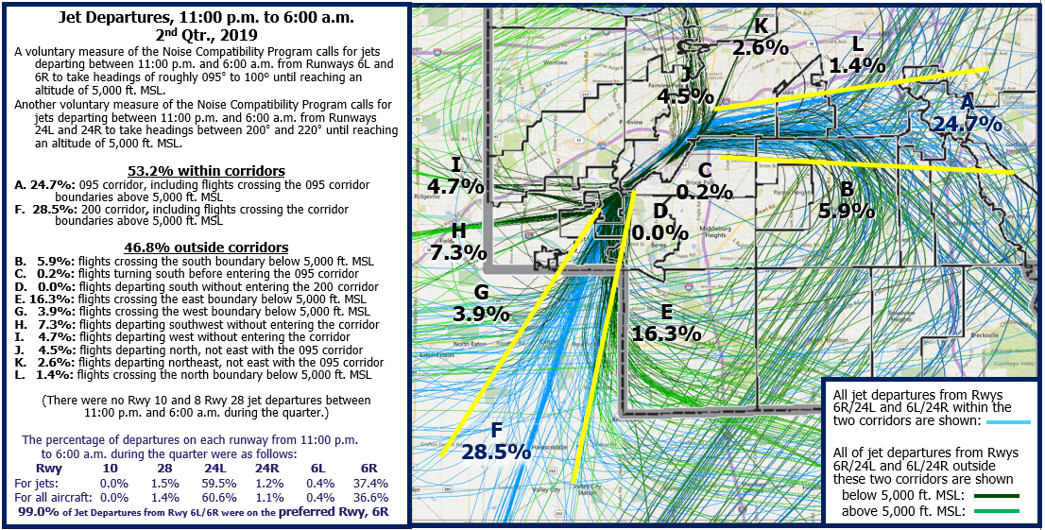
Departure Headings, 2nd Qtr: Night-time

Slide 11
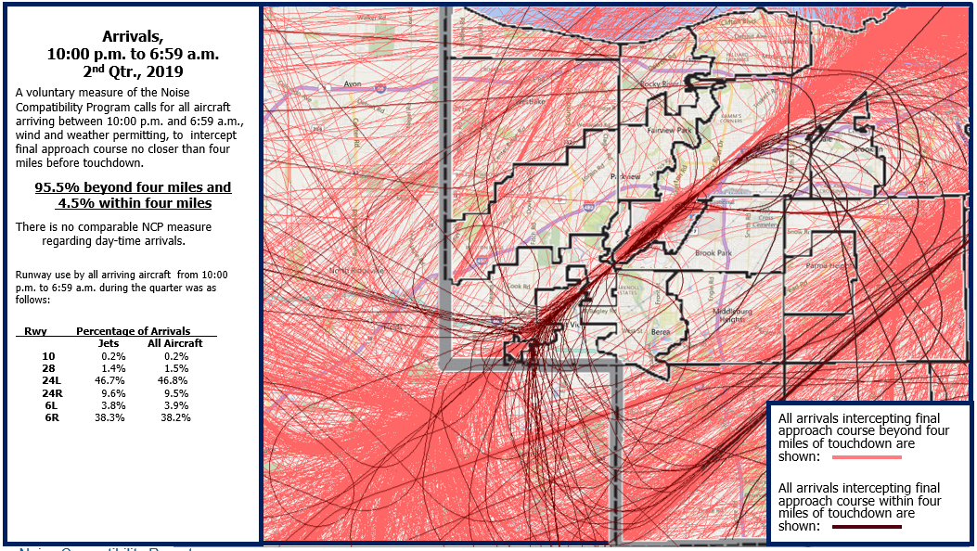
Arrival Headings, 2nd Qtr: Night-time

Slide 12
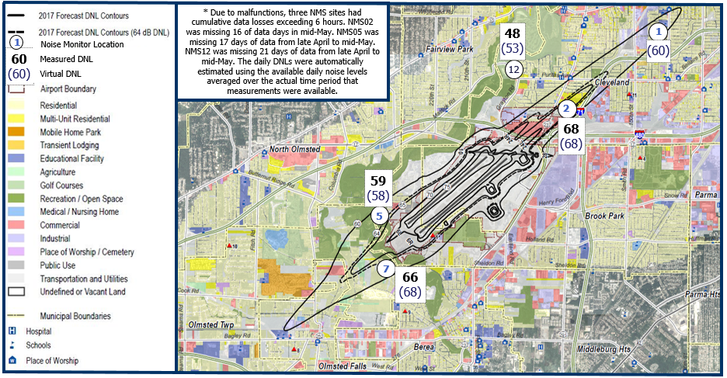
Aircraft Noise: DNL by Noise Monitoring Site

Slide 13
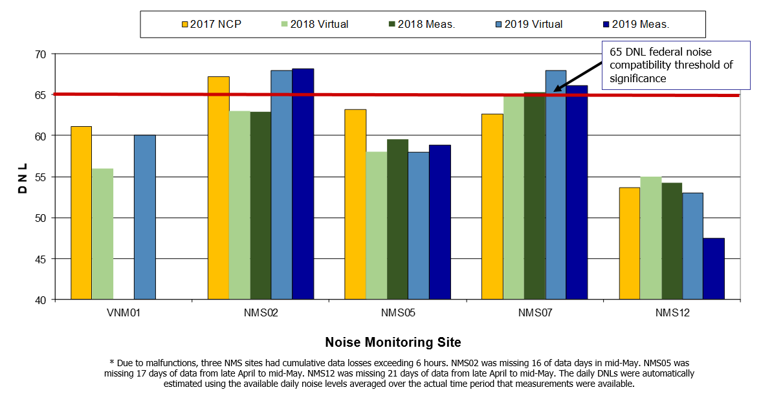
DNL: 2nd Qtr., 2019 vs. 2nd Qtr., 2018

Slide 14
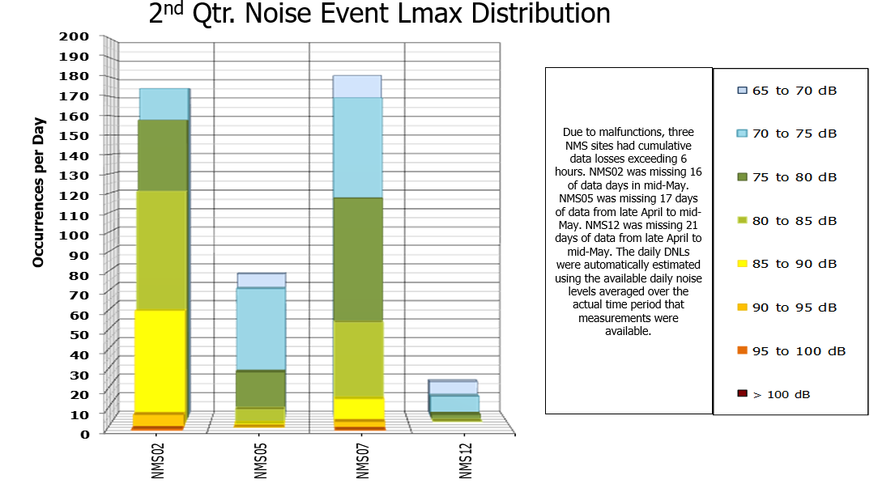
Average Daily Number of Aircraft Noise Occurrences Above Each 5 dB Increment

Slide 15
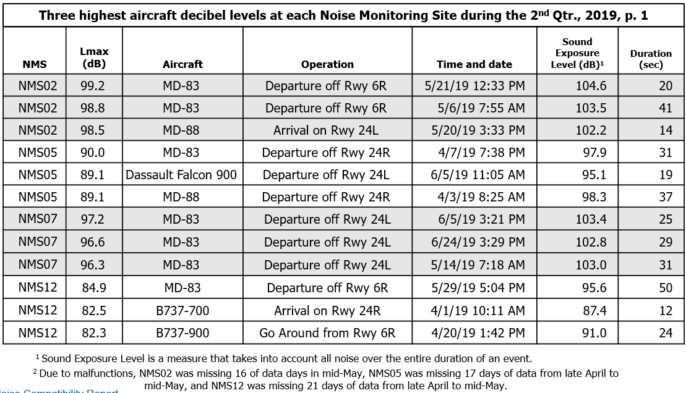
Top Three Lmaxs at Each NMS

Slide 16
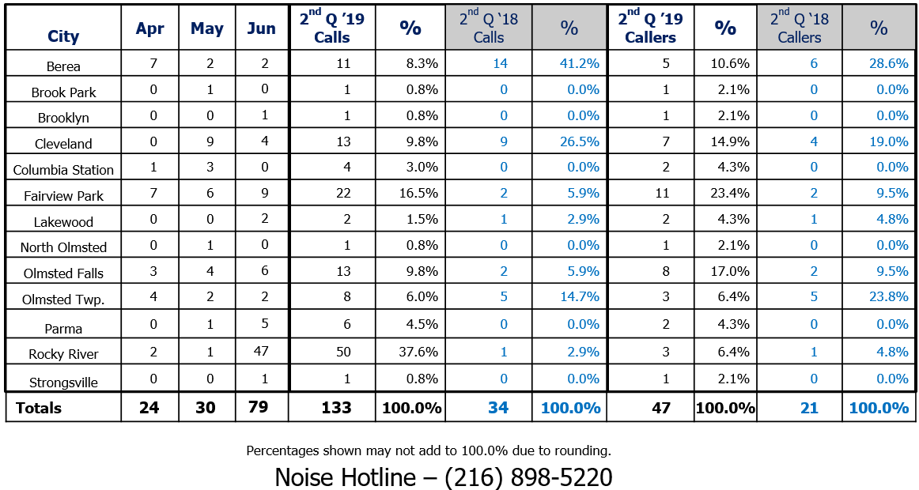
Noise Complaints

Slide 17
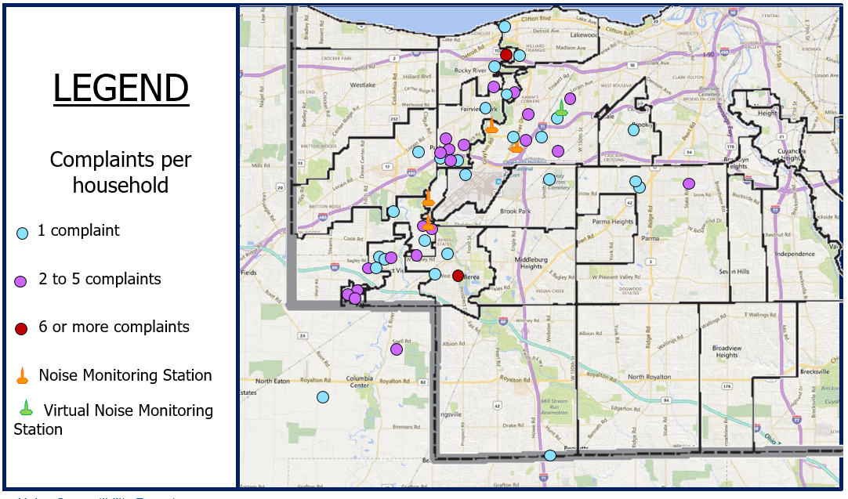
2nd Quarter Complaint Map

